Slide 1
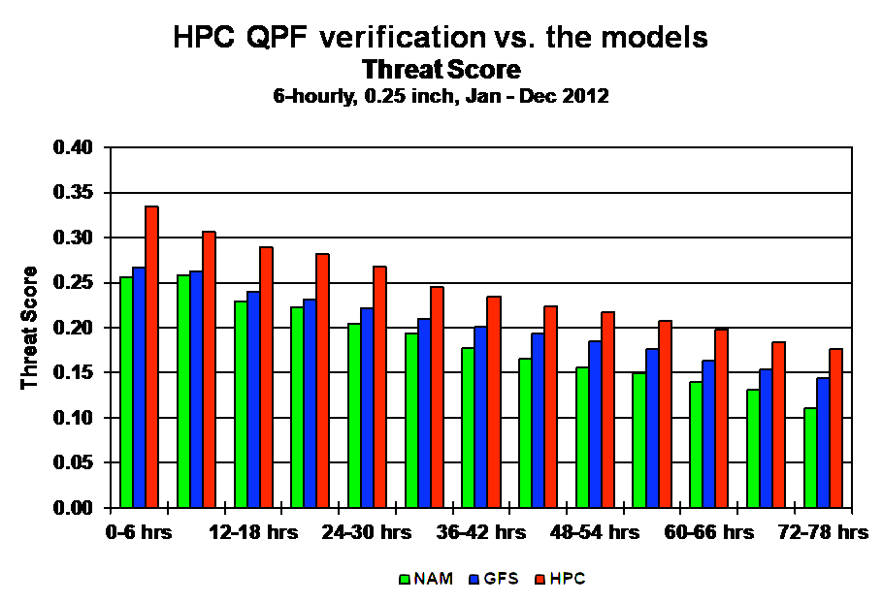
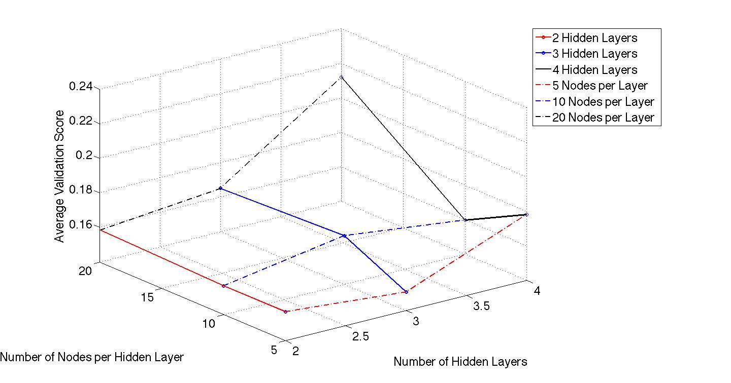
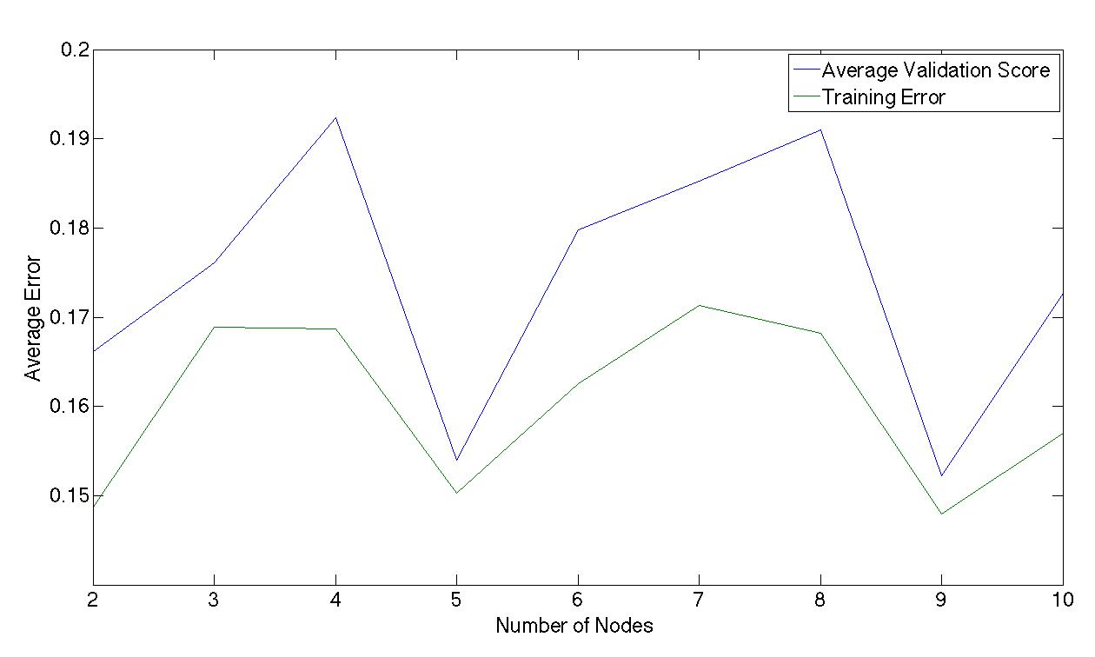
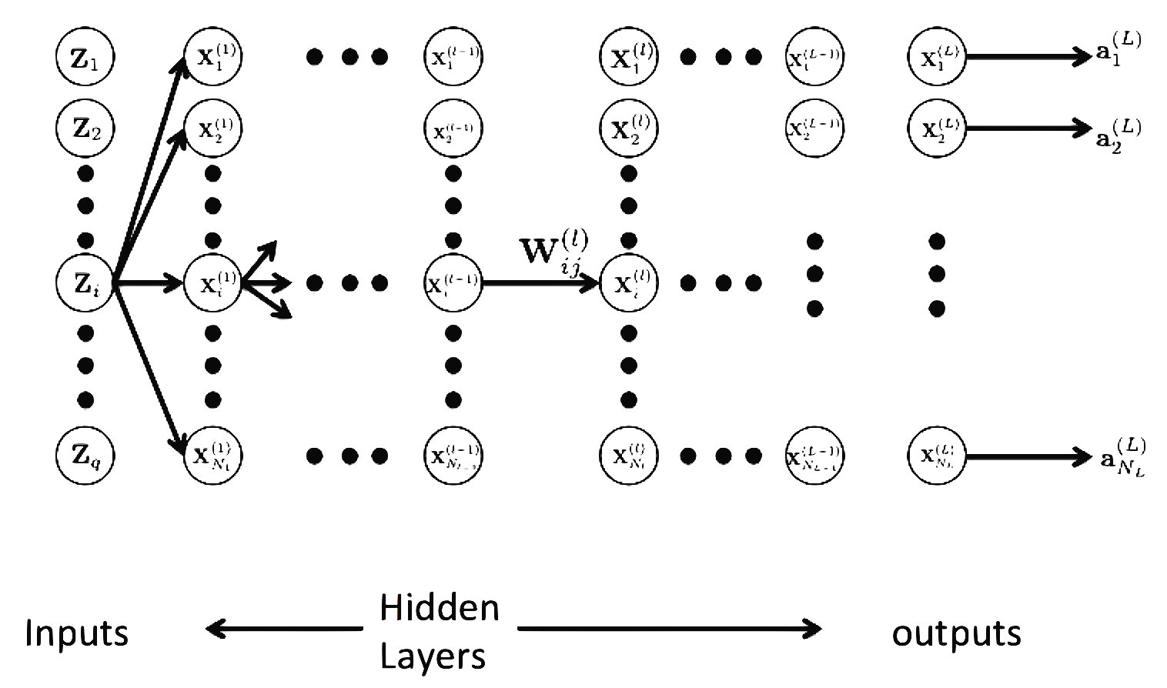
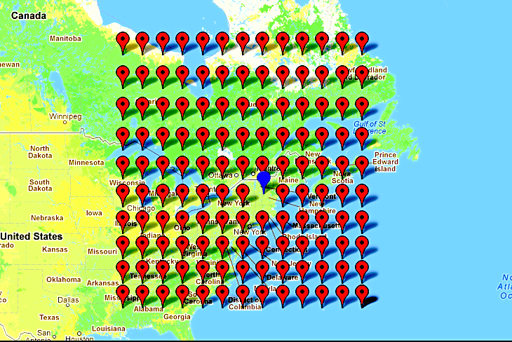
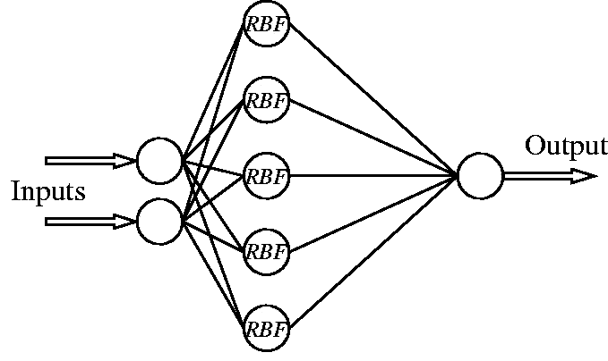
Problem
Predicting Precipitation in Hanover
Using Neural Networks
Results
Currently, precipitation predictions using physical simulations are inaccurate (Figure 1). We aim to predict precipitation amounts 6, 12, 18 or 24 hours in advance in Hanover, NH.
Using 10-Fold cross validation we trained our feed forward neural network over nine different network structures varying the number of hidden layers and the number of nodes per layer. We trained our networks using both classification and regression data:
Christopher Hoder and Ben Southworth
Approach
Network 1
To obtain the best results we implemented a cascade model which first predicts precipitation or no precipitation and then uses a second network to provide a prediction of actual precipitation amount (Figure 3).
No precipitation
Network 2
Figure 6. Average Validation scores for 10-Fold Cross validation Classifying 6 hours ahead
Figure 7. Average validation scores for 10-Fold cross validation of networks with 2 hidden layers and varying number of nodes
Figure 1. Threat Score or accuracy rating on a scale of 0 to 1 for modern physical weather simulations used to predict precipitation
Precipitation Prediction
For the RBF we trained using both the Gaussian and thin-plate spline with the following hidden layer sizes: k = 100, 500 and 1,000. Additionally, we examined different ways to pick the center vectors of our sample space through randomly assigned vectors and an orthogonal least squares selection process.
Our best results are contained in the table below with comparisons to simpler models.
Figure 3. Data flow in our cascade prediction model
Data
Feed-Forward Network
Our data was obtained from the Physical Sciences Division of the National Oceanic and Atmospheric Administration. Measurements were taken from a grid of stations roughly 2000 x 2000 miles providing us with 33,600 labeled examples and 2,470 features (Figure 2).
At Surface:
Wind direction (u,v)
Relative humidity
Mean sea level pressure
Pressures,
500mb, 700mb, 850mb:
Wind direction (u,v)
Relative humidity
Specific humidity
Geopotential height
We implemented a generalized feed-forward back propagation neural network which allows for an arbitrary number of hidden layers and arbitrary number of nodes at each layer (Figure 4). Our training objective is to minimize the sum squared error:
Table 1. A comparison of the error rates for different prediction models on our test set across different prediction time frames varying from 6 hours to 24 hours.
Where is the i^{th} output value and t_{i} is the labeled output. This is accomplished through stochastic back propagation and line search optimization methods.
Model | Prediction time frame | % wrong of precip | % wrong of non precip | Overall Error Rate
Logistic Regression | 6 | 13.469 | 39.536 | 38.079
Forest of Decision Trees | 6 | 36.031 | 1.850 | 10.228
kNN (k=5) | 6 | 68.980 | 1.788 | 5.544
Neural Network (best) | 6 | 12.121 | 17.869 | 17.742
Radial Basis Function (best) | 6 | 30.204 | 4.785 | 6.206
Logistic Regression | 12 | 25.673 | 24.942 | 25.023
Forest of Decision Trees | 12 | 66.874 | 2.053 | 9.201
kNN (k=5) | 12 | 62.940 | 4.260 | 10.731
Neural Network (best) | 12 | 14.493 | 45.856 | 42.397
Radial Basis Function (best) | 12 | 26.294 | 12.574 | 14.077
Logistic Regression | 18 | 30.682 | 29.260 | 29.488
Forest of Decision Trees | 18 | 73.864 | 2.640 | 14.093
kNN (k=5) | 18 | 64.915 | 7.431 | 16.674
Neural Network (best) | 18 | 32.955 | 33.234 | 33.189
Radial Basis Function (best) | 18 | 25.852 | 24.986 | 25.097
Logistic Regression | 24 | 41.209 | 28.650 | 31.261
Forest of Decision Trees | 24 | 78.132 | 4.299 | 19.653
kNN (k=5) | 24 | 64.066 | 12.435 | 23.172
Neural Network (best) | 24 | 85.385 | 10.906 | 26.394
Radial Basis Function (best) | 24 | 25.494 | 35.516 | 33.379
Figure 4. A generic Neural Network structure containing L layers, N_{l} nodes per layer, N_{L} outputs, Z_{q} inputs and the activation function at Node i on layer j is given by
Figure 2. Map showing the observation locations for our data
Radial Basis Function (RBF)
State of the Art
The advantage to RBF networks is that there exists a closed form solution for network weights. RBF network’s have one hidden layer of arbitrary size as shown in Figure 5, with weights given by W^{T} = ϕ^{Ŧ}Y, where
Previous research into machine learning applications in weather prediction have focused mainly on neural networks [1]-[5]. Santhanam et all achieved classification error rates of 18% and 11.51% using feed-forward and radial basis networks respectively [1].
Figure 5. A Generic RBF structure
Conclusions
ϕ^{ŧ} is the pseudo-inverse of ϕ. The activation function, ϕ(X;C,σ) where C is the center vector and σ is the average distance between all C’s and the sample X, is given below:
Citations
Our results performed on par with that of Santhanam et all for 6 hour predictions. We also demonstrated moderate success predicting 12,18 and 24 hours in advance. Furthermore our cascade classifier was able to run on our 6 hour test set with a sum squared error of 0.0012, miss classifying only 12 out of 99 precipitation days
[1] Santhanam, Tiruvenkadam, and A. C. Subhajini. “An Efficient Weather Forecasting System using Radial Basis Function Neural Network." Journal of Computer Science 7.
[2] Maqsood, Imran, Muhammad Riaz Khan, and Ajith Abraham. “An ensemble of neural networks for weather forecasting." Neural Computing \& Applications 13.2 (2004): 112-122.
[3] French, Mark N., Witold F. Krajewski, and Robert R. Cuykendall. “Rainfall forecasting in space and time using a neural network." Journal of hydrology137.1 (1992): 1-31.
[4] Kuligowski, Robert J., and Ana P. Barros. ``Localized precipitation forecasts from a numerical weather prediction model using artificial neural networks." Weather and Forecasting 13.4 (1998): 1194-1204.
[5] Hall, Tony, Harold E. Brooks, and Charles A. Doswell III. ``Precipitation forecasting using a neural network." Weather and forecasting 14.3 (1999): 338-345.
or
Predictions are made with the following Equation:
y_{pred} = Wϕ(X_{test}).
Notes:
, and is the activation function of a sample matrix X for given center vectors C and distance σ.

